Slide 1

OR.NET & IHE Germany SDC Plug-a-thons
David Gregorczyk System Architect @ Drägerwerk AG
Icon made by https://www.freepik.com

Slide 2
Outline
Scope and Purpose
Plug-a-thon #1
Plug-a-thon #2
Plug-a-thon #3
Future Plug-a-thons

Slide 3
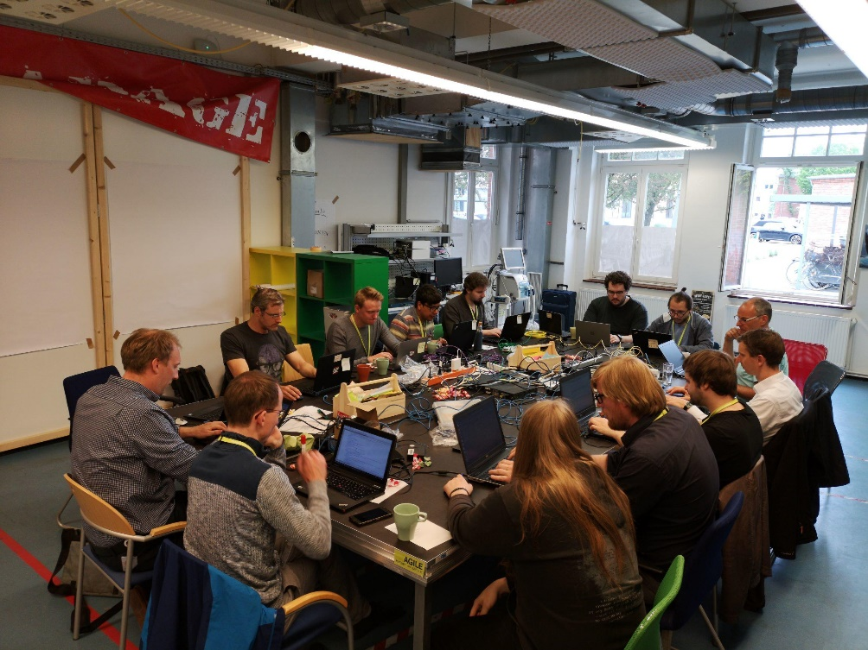
Scope and Purpose
Informal collaboration of engineers within the boundaries of a joint meeting of OR.NET and IHE Germany
Establish interoperability between different SDC implementations and between devices from different vendors
Formalize SDPi transactions and test against those to facilitate conformance testing
~ bi-monthly meeting
Documentation: Community Events - Gemini Public - Confluence (hl7.org)
⬆ COVID-free OR.NET-only meeting in 2019

Slide 4
PAT #1 Kick-off meeting 2020/10
2020.10.20-21 IHE Germany SDPi PAT - Gemini Public - Confluence (hl7.org)
Virtual venue due to the pandemic and in order to reduce expenses
VPN hosted by OR.NET to allow all parties exchanging data in a virtual subnet, and by that utilzing UDP multicast
SoftEther VPN
Marcus Köny can provide access data and user accounts
VPN paves the way for long-term offline testing, i.e. testing without the need to come together at plug-a-thons or connectathons
The group devised a test sequence that covers large parts of the communication scope of SDC
Mainly difficulties with certificates

Slide 5
PAT #2 2021/03
2021.03.24 IHE DE SDC/SDPi PAT #2 - Gemini Public - Confluence (hl7.org)
Setup of an interoperability matrix to show which implementations are successfully connecting and exchanging data with each other
Plug-a-thon was closed with a sketchy interoperability matrix and an almost working certificate infrastructure (SSL 1.2 vs 1.3 is still an issue)

Slide 6
PAT #3 2021/06
2021.06.01 IHE DE SDC/SDPi PAT #3 - Gemini Public - Confluence (hl7.org)
Continuing on the interoperability matrix – on a clean slate to verify reproducibility
A docker container has been created with a VPN adapter connecting to the OR.NET SoftEther VPN → can be used as a base for containers that run test apps to test against offline
Introduction slide set will be published by the time the next PAT is going to be conducted
First shot of a test sequence to SDPi transaction mapping: Reference Provider/Consumer Specification - Gemini Public - Confluence (hl7.org) (no full coverage yet)

Slide 7
Next: PAT #4 2021/08
Detailing of test sequence
Get coverage of test sequence to SDPi transactions mapping
Create provisional test app based on SDCri to generate JUnit test reports
SDCcc isn‘t published as open source yet; a lean test app as first shot is good-enough for the moment

Slide 8


Challenge
It‘s still unclear how to test a consumer
A „golden device“ provider that checks specific interaction?
Test app
Device under test
Test result

Provider
Test result
⬧
Consumer

Slide 9
Thank you!
David Gregorczyk

